Slide 1

Macroeconomic heatmap taking the temperature of the Estonian economy
Lauri Punga
Fiscal Council of Estonia
Riga, 11 June 2018

Slide 2
Introduction
‘Heatmaps’ have become quite popular as a means of visually representing a wide range of data in fast and convenient manner + easy to understand for the average reader
Tool that helps to formulate our understanding of the Estonian economic cycle
  to assess the output gap estimates in the macroeconomic forecasts produced by the Ministry of Finance
  to assess compliance with the national structural balance rule

Slide 3
Measuring the economic cycle
Output gap is unobservable and therefore have to be estimated
1) statistical filters
2) production functions
3) ‘cyclical indicators’ approach
‘Cyclical indicators’ approach – a wide range of high frequency indicators that might be expected to reflect cyclical development; attempt to measure the state of the cycle directly from survey data (consumer confidence & business conditions), labor market and financial indicators

Slide 4
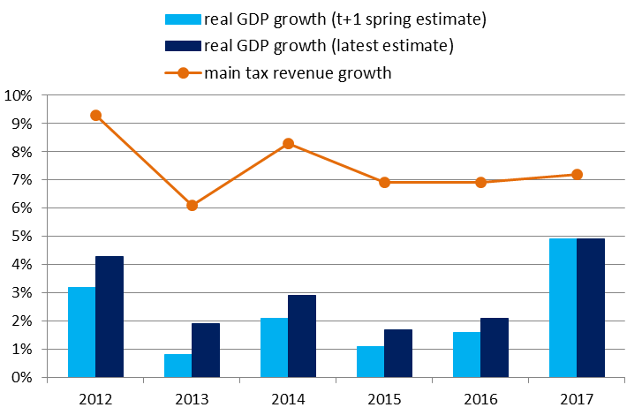
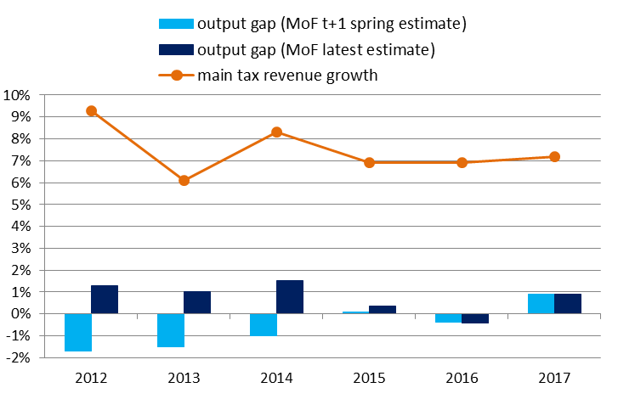
Output gap & fiscal policy
Output gap is a summary indicator that may not always best describe the macro developments that influence tax revenues
Wise not to rely on a single method or measure, but to account for a wider range of indicators

Slide 5
Constructing a ‘heatmap’
Heatmap of the Estonian economy uses quarterly data and a total of 10 economic indicators to describe the current cyclical position of the economy and how it has developed
This analysis is presented in the form of a ‘heatmap’ (or a weather map)
  darker shade of blue → economy is cooling
  darker shade of orange → economy is overheating
Good times: rapid wage growth and inflation, low unemployment, high employment & capacity utilization, lots of vacancies, strong economic sentiment and strong demand
Advantages: not as prone to revisions (so real-time data have more value), can be updated each quarter without relying on MoF’s estimates or forecasts

Slide 6
Selection of indicators
Selection of indicators:
  data available for each quarter
  historically strongly linked with the economic cycle → correlation analysis
  preferred ‘level’ indicators to growth rates (more similar to the output gap concept)
  altogether give a sufficiently broad picture of the Estonian economy
Final selection:
  5 indicators of the labour market and price level
  5 so-called ‘soft indicators’ from survey data

Slide 7
Data & methodology
To convert the data into orange-and-blue colour scale, the quarterly value for each indicator is compared with its long-term average value
Sample period starts from 2007Q1
Each value is normalized by subtracting the series mean and dividing by its standard deviation (to take into account differences in long-term trends and volatility across series)
Heatmap’s shadings are determined by the number of SDs from the mean for each component → 2 (or more) SDs below the mean is assigned the darkest blue, while 2 (or more) SDs above the mean is shaded the darkest orange; observations close to mean are shaded white
MS Excel → Conditional Formatting → New rule → 3-Color Scale

Slide 8
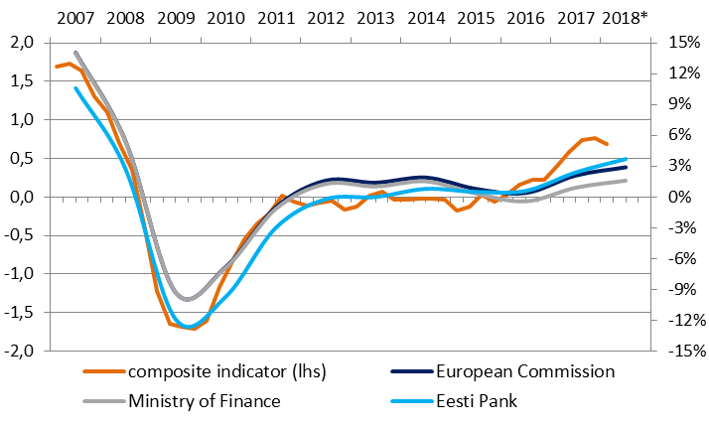
Composite indicator
Composite indicator (row under the line) is made up as an average of all the economic indicators used in the heatmap
... with equal weights
Relatively good match with various output gap estimates

Slide 9
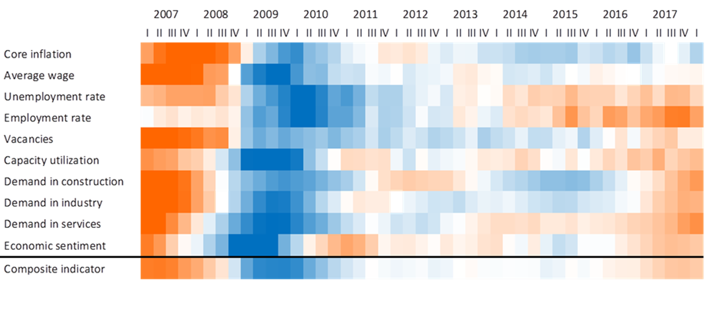
Latest update – 2018Q1
Heatmap updated with 2018Q1 data (not shown on the handouts)
Broad-based improvement in the last two years
Last 3 quarters relatively similar strong state of the cycle

Slide 10
In conclusion
‘Heatmap’ is a fast and efficient way to assess data both in the short-term and over longer time periods
A good visual tool we can use in our papers & presentations
Another tool in the Council’s toolbox that we can use in our thinking regarding the Estonian economic cycle
Possible to build similar maps that focus on a more specific area of the economy (e.g. prices, labor market, tax revenues)

Slide 11
Contacts of the Fiscal Council
Chairman Raul Eamets
raul.eamets@ut.ee
+372 514 0082
Secretary to the Council
info@eelarvenoukogu.ee
www.eelarvenoukogu.ee

Slide 12
Data & sources
Indicator | Full description | Unit | Source
Core inflation | HICP excluding energy, food, alcohol and tobacco | % change y-o-y, quarter = 3 month average | Eurostat
Average wage | Average monthly gross wages, all economic activities | % change y-o-y | Statistics Estonia
Unemployment rate | Unemployment rate, population aged 15-74 | % | Statistics Estonia
Employment rate | Employment rate, population aged 15-74 | % | Statistics Estonia
Vacancies | Number of job vacancies, all economic activities | Total | Statistics Estonia
Capacity utilization | Current level of capacity utilization in manufacturing industry | %, seasonally adjusted | Eurostat
Demand in construction | Construction survey: 'insufficient demand' as the main factor limiting building activity | % of enterprises, 4 quarter average, quarter = 3 month average | Estonian Institute of Economic Research
Demand in industry | Industry survey: 'insufficient demand' as the main factor currently limiting production | % of enterprises, 4 quarter average | Estonian Institute of Economic Research
Demand in services | Services survey: 'insufficient demand' as the main factor currently limiting business | % of enterprises, 4 quarter average | Estonian Institute of Economic Research
Economic sentiment | Economic Sentiment Indicator, composite indicator made up of five sectoral confidence indicators | Level, quarter = 3 month average, seasonally adjusted | Estonian Institute of Economic Research

