Slide 1

Fiscal sustainability

Slide 2
EPC’s mandate
The Economic Policy Council was established in January 2014 to provide independent evaluation of economic policies in Finland. According to the government decree (61/2014) the council should evaluate:
the appropriateness of economic policy goals;
whether the goals have been achieved and whether the means to achieve the policy goals have been appropriate;
the quality of the forecasting and assessment methods used in policy planning;
coordination of different aspects of economic policy and how they relate to other social policies;
the success of economic policy, especially with respect to economic growth and stability, employment and the long-term sustainability of public finances;
the appropriateness of economic policy institutions.

Slide 3
S1 and S2 indicators for fiscal sustainability
The medium term indicator S1 shows the additional fiscal adjustment effort required (in terms of improvement in the government structural primary balance) over five post-forecast years to reach the 60% of GDP debt ratio target in 2032
The long term indicator S2 shows the upfront fiscal adjustment (to the government structural primary balance) required to stabilise the debt ratio over the infinite horizon

Slide 4
S1 and S2 indicators for fiscal sustainability
The medium term indicator S1 shows the additional fiscal adjustment effort required (in terms of improvement in the government structural primary balance) over five post-forecast years to reach the 60% of GDP debt ratio target
in 2032
The long term indicator S2 shows the upfront fiscal adjustment (to the government structural primary balance) required to stabilise the debt ratio
over the infinite horizon

Slide 5
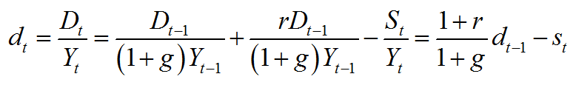
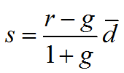
Simple debt dynamics:
The primary surplus that holds the debt-to-GDP ratio constant depends on interest rate, growth rate and debt-to-GDP ratio

Slide 6
Projections to 2060 indicate the need for fiscal adjustments in Finland

Slide 7
The increase of age-related costs decreases the primary surplus

Slide 8
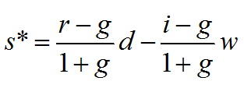
Long-run fiscal sustainability in Finland
In the long run, i.e. after 2060, interest on wealth and debt are higher than the nominal growth rate
  i>r>g
  If also w>d -> debt stabilizing primary surplus is negative

Slide 9
Fullfilling the required adjustment would stabilize the debt below 15% to GDP

Slide 10
Path to stable, but low, deb-to-GDP ratio is hard to motivate to the audience
Higher stable debt-to-GDP ratio
-> higher primary surplus or higher wealth
-> higher initial adjustment
but with higher primary surplus, debt would be consumed before 2060
Any partial adjustment would not lead to sustainability in infinite horizon

Slide 11
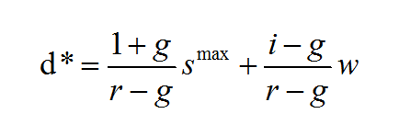
Maximum sustainable debt
Maximum sustainable debt-to-GDP ratio depends on growth and interest rates, on wealth and on maximum primary surplus that citizens can tolerate
s ^{max} also defines the maximum speed of adjustment towards possible debt target

Slide 12
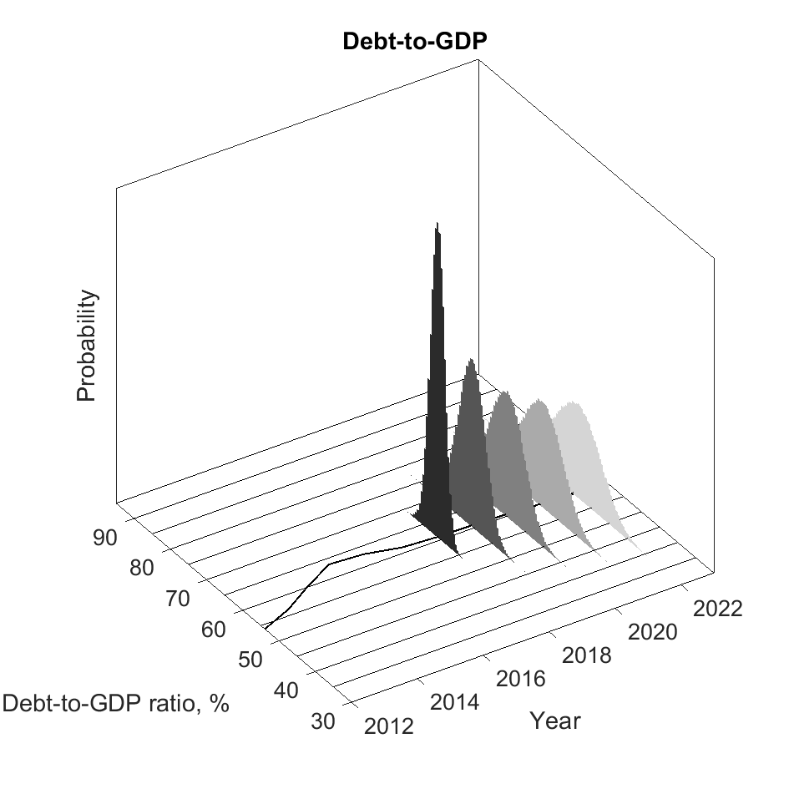
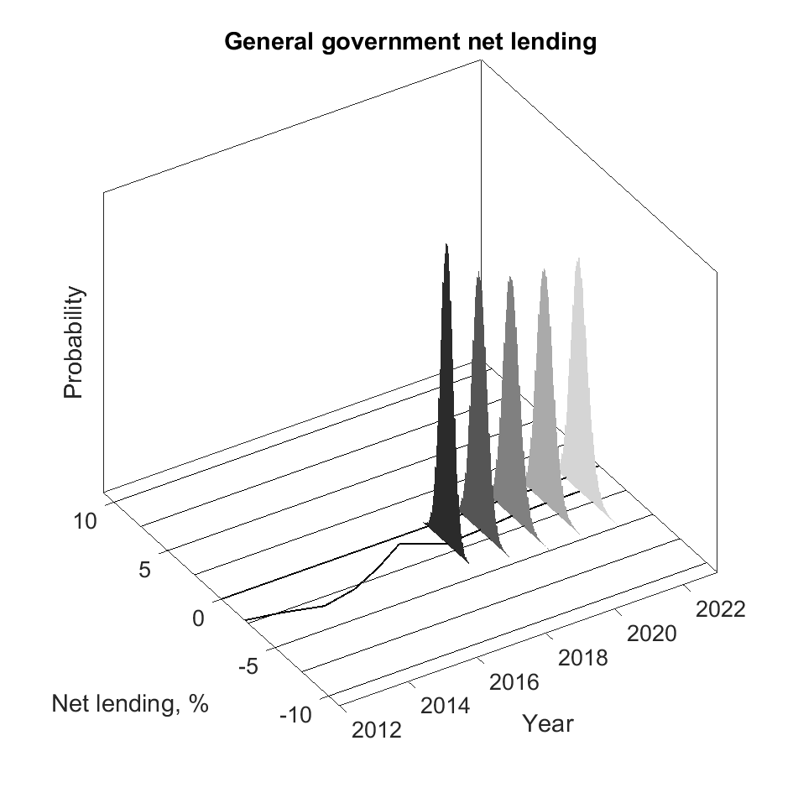
In the medium-term, such thresholds should not be reached
Source: EPC.

Slide 13
Questions
Are public finances sustainable,
as long as the primary surplus required to decrease the debt is below the maximum tolerable primary surplus,
s ^{max} ?
Is the debt-anchor with a primary surplus target enough to secure long-run sustainability?

