Slide 2
Tax Forecasting Error Decomposition
Saulė Skripkauskienė
Senior Advisor of the Budget Policy Monitoring Department.
11th of June, 2018

Slide 3
Tax Forecasting Error Decomposition
Motivation
Oft heard narrative: Forecasting errors are mostly due to better economic performance or decreased shadow economy. But is it really the case?
Objectives:
to examine the tax revenue forecasting performance of the Ministry of Finance over the period 2012–2017
to decompose to what extent the error of the tax plan was determined by unexpected economic developments

Slide 4
Tax Forecasting Error Decomposition
Forecasting Errors of the Major Tax Plans for 2012–2017
Source: fiscal institution’s calculations

Slide 5
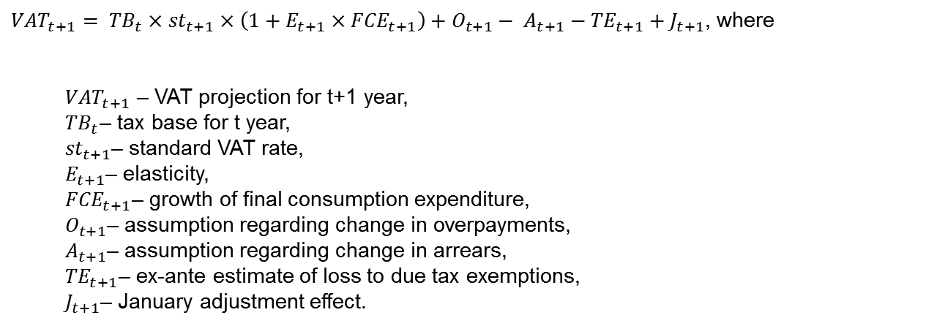
Tax Forecasting Error Decomposition
Method
${VAT}_{t+1}= {TB}_{t}×{st}_{t+1}×\left(1+E_{t+1}×{FCE}_{t+1}\right)+O_{t+1}− A_{t+1}−{TE}_{t+1}+J_{t+1}$, where
${VAT}_{t+1}$ – VAT projection for t+1 year,
${TB}_{t}$– tax base for t year,
${st}_{t+1}$– standard VAT rate,
$E_{t+1}$– elasticity,
${FCE}_{t+1}$– growth of final consumption expenditure,
$O_{t+1}$– assumption regarding change in overpayments,
$A_{t+1}$– assumption regarding change in arrears,
${TE}_{t+1}$– ex-ante estimate of loss to due tax exemptions,
$J_{t+1}$– January adjustment effect.

Slide 6
Tax Forecasting Error Decomposition
Personal Income Tax Forecasting Error by Income Types
Sources: Ministry of Finance, State Tax Inspectorate, fiscal institution’s calculations

Slide 7
Tax Forecasting Error Decomposition
Error Decomposition of the „PAYE“ component of the Income Tax
Sources: Ministry of Finance, State Tax Inspectorate, fiscal institution’s calculations

Slide 8
Tax Forecasting Error Decomposition
Error Decomposition of Corporate Income Tax Plans
Sources: Ministry of Finance, State Tax Inspectorate, fiscal institution’s calculations

Slide 9
Tax Forecasting Error Decomposition
Value-Added Tax Forecasting Error Decomposition
Sources: Ministry of Finance, State Tax Inspectorate, fiscal institution’s calculations

Slide 10
Tax Forecasting Error Decomposition
Excise Duties Plans Errors by Product Groups
Sources: Ministry of Finance, State Tax Inspectorate, fiscal institution’s calculations

Slide 11
Tax Forecasting Error Decomposition
Excise Duties Plans Errors by Products
Sources: Ministry of Finance, State Tax Inspectorate, fiscal institution’s calculations

Slide 12
Tax Forecasting Error Decomposition
Error Decomposition of Excise Duties by Products (1)
Sources: the Ministry of Finance, State Tax Inspectorate, fiscal institution’s calculations

Slide 13
Tax Forecasting Error Decomposition
Error Decomposition of Excise Duties by Products (2)
Sources: Ministry of Finance, State Tax Inspectorate, fiscal institution’s calculations

Slide 14
Tax Forecasting Error Decomposition
The Contribution of Macroeconomic Drivers:
PERSONAL INCOME TAX
Annual growth rate of the fund for wages and salaries
CORPORATE PROFIT TAX
Annual growth rate of the nominal GDP
VALUE-ADDED TAX
Annual growth rate of the final consumption expenditure
Absolute size of tax errors and their DRIVERS
An average contribution of the macroeconomic driver to the absolute size of tax error

Slide 15
Tax Forecasting Error Decomposition
The Contribution of the Starting Point:
PERSONAL INCOME TAX
CORPORATE INCOME TAX
VALUE-ADDED TAX
Absolute size of tax errors and their DRIVERS
An average contribution of the starting point to the absolute size of tax forecasting error

Slide 16
Tax Forecasting Error Decomposition
About 30 % of the Excise Duties Errors Are Due to the Starting Point
WINES AND OTHER FERMENTED SPIRITS
ETHYL
BEER
CIGARETTES
PETROL FUEL
DIESEL FUEL
LIQUIFIED GAS FUEL
Absolute size of tax errors and their DRIVERS
An average contribution of the starting point to the absolute size of tax forecasting error

Slide 17
Tax Forecasting Error Decomposition
Summary (1)
During the analysed period, on average:
50 % of absolute size of the personal income tax errors was determined by the projection errors of labour market indicators
12.9 % of the absolute size of the corporate tax errors was determined by faster or slower economic growth
20.8 % of the absolute size of the value-added tax errors followed from the final consumption expenditure forecasting errors
about 30 % of the excise duties errors are due to the starting point

Slide 18
Tax Forecasting Error Decomposition
Summary (2)
Decompositions suggest that the relative contribution of different error sources towards the overall error varies over time and by tax head
The exercise reveals that, on occasion, relatively small overall forecast errors mask larger offsetting component errors

Slide 19

Assessment Report „Tax Forecasting Error Decomposition“ |  |  | Saulė Skripkauskienė Senior Advisor of the Budget Policy Monitoring Department (+370 5) 204 7646 Saule.Skripkauskiene@ifi.lt www.ifi.lt @valstybeskontrole

