Slide 1
Costing election manifestos: Experience from Latvia and the Netherlands
Dace Kalsone, Secretary, Fiscal Discipline Council
Janis Platais, Chairman, Fiscal Discipline Council
Sander van Veldhuizen, CPB
for EFB conference

Slide 2
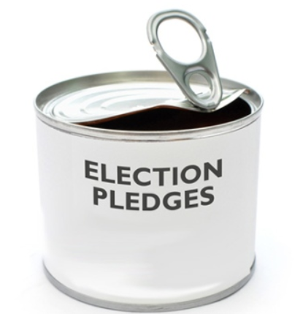
Why launching the survey?
Latvia has been facing national elections in October 2018
Political parties have been coming up with unrealistic promises and assumptions in their pre-election programmes and debate
Good experience accumulated internationally, particularly in Netherlands

Slide 3
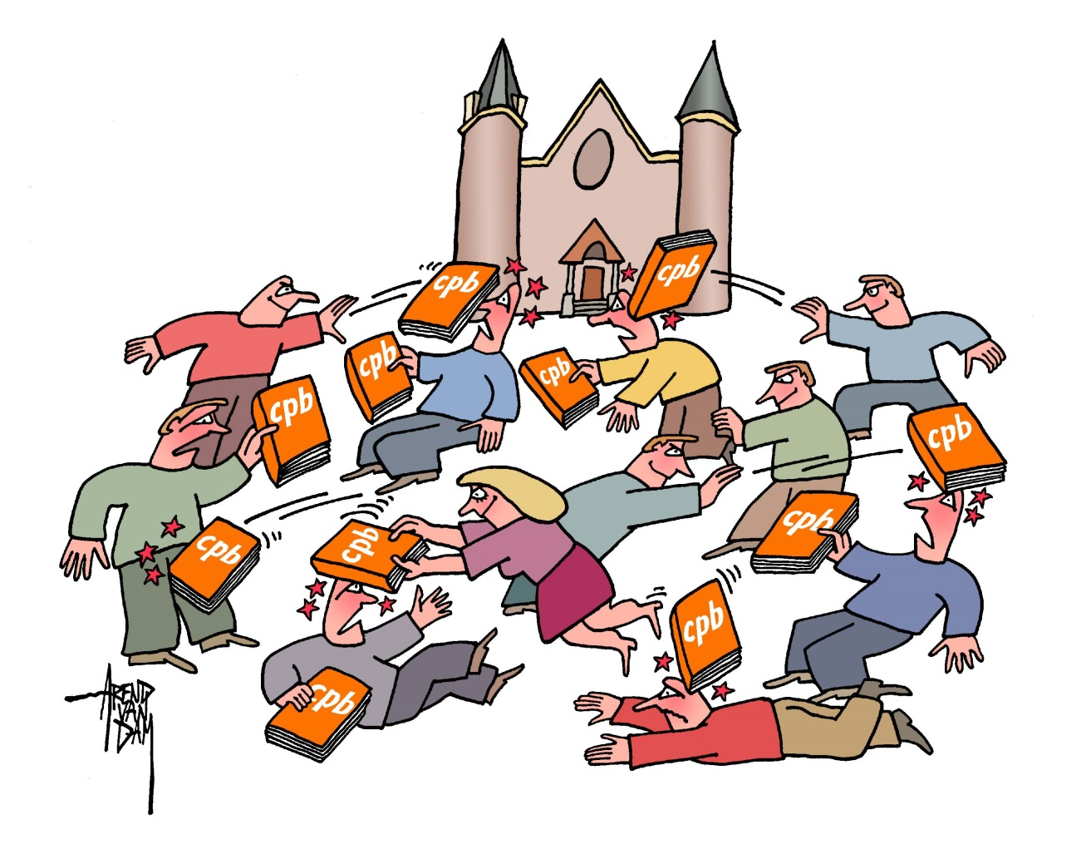
CPB publications often used in policy debates

Slide 4
In the Netherlands since 1986

Slide 5

Back to Latvia case: the rules are strict
MS Excel based tool with fiscal policy simulation based on the latest Stability Programme
Understand fiscal policy constraints
Commit to follow the requirements
Record priorities with significant fiscal impact
Identify compensating measures
Pay attention to contingencies and risks

Slide 6

Engaging political parties
Through a meeting in the Parliamentary Budget Committee, E-mail, and direct contact
Encouraging new political parties to demonstrate their capacity to formulate and cost their policies
Inviting old political parties to constrain populism
Equal treatment

Slide 7

Response rate
6 out of 16 parties running in the elections, receiving 50% of seats in the Parliament
3 parties excused from providing their simulations in MS Excel model, while promised keeping the fiscal discipline

Slide 8
Deviation from the budget balance baseline
Period | Baseline | Jaunā konservatīvā partija | Nacionālā apvienība | No sirds Latvijai | Attīstībai/Par! | Progresīvie | Jaunā Vienotība
2019 | -1.0 | 0.2 | 0.0 | -1.4 | 0.3 | 0.1 | -0.4
2020 | -0.4 | -0.3 | 0.0 | -1.3 | 0.3 | 0.4 | -0.6
2021 | -0.4 | -0.9 | 0.0 | -1.3 | -0.1 | 0.7 | 0.3
2022 | -0.4 | -1.0 | 0.0 | -1.2 | -0.3 | 1.0 | 0.7
Average 2019-2022 | -0.5 | -0.5 | 0.0 | -1.3 | 0.0 | 0.6 | 0.0

Slide 9

Some other highlights
Debt level target from 34.0% to 36.8% to GDP by end 2022 compared to 35.6% according to the baseline and debt level at 40.2% at the end of 2017
Tax revenue to GDP ratio to the levels from 30.4% to 34.3% to GDP – all parties projecting increase compared to the baseline at 30.3%

Slide 10

How to assess the results?
Most components of the survey worked well
The costing and assumptions behind the measures to cut costs or increase revenue have been less plausible – need for solid technical support
Not enough time for political parties to formulate the policies and assess their plausibility

Slide 11
Latvia: Some outcomes
Some political parties stressed the significance of the costing exercise and used this widely in the election campaign
The credibility and the stability of the pre-election commitments turned out very important in post-elections developments
Split parliament took 109 days to agree on a new coalition (5 out of 7 parties elected) that could secure the support of the majority, while the Coalition concluded a Fiscal Pact

Slide 12

500 policy measures in Charted Choices originate from Promising Policies
In NL: before election manifestos CPB publishes Promising Policies

Slide 13
Coalition Agreements are key in the Netherlands
One key decision moment on budgetary policy every 4 years after the general election.
  Lengthy negotiations
  Detailed agreements
  Trend-based budgetary policy since 1994.
In case the government or a coalition party wants a change in the Agreement it needs to provide an alternative with the same budgetary impact.

Slide 14
In NL: Baseline was not bad
steady growth
unemployment stabilizes

Slide 15
Budget balance increases
In NL: Baseline was not bad
Debt falls

Slide 16

Sustainability balance
Dijsselbloem: “The only relevant figure for the spending limit is the sustainability surplus, which shows the affordability of the welfare state in the long term”
Source: Dutch Financial Times, 29 mei 2017.

Slide 17
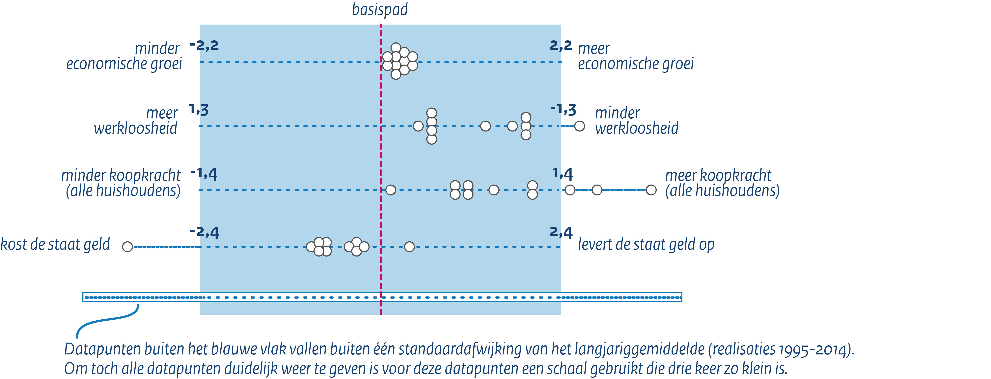
Results - Within the cabinet period
GDP growth (%)
Unemployment (%-point)
Purchasing power
Budget balance (% GDP)

Slide 18
Nearly everything in Coalition agreement in some form in Charted Choices

Slide 19
Thank you!
LATVIA
Fiscal Discipline Council
Smilšu Str 1-512 Riga LV-1919
Phone: +371 6708 3650
E-mail: info@fdp.gov.lv
Web: http://fdp.gov.lv
Twitter: @Fiskalapadome
Facebook: fiskalapadome
NETHERLANDS
Centraal Planbureau
P.O. Box 80510
2508 GM The Hague
Phone: +31 88 9846000
E-mail: info@cpb.nl
https://www.cpb.nl/en

