Slide 1
The introduction of the euro in Latvia
Dace Kalsone
Fiscal discipline council of the Republic of Latvia

Slide 2
Agenda
The influence of euro on inflation, GDP, unemployment and other macro factors
Are citizens satisfied with the euro currency, what are the opinions?
The most important challenges during the implementation process, what methods of making the new currency and the transition familiar for Latvians were successful, what methods were less successful
All unpredictable troubles and what others should avoid

Slide 3
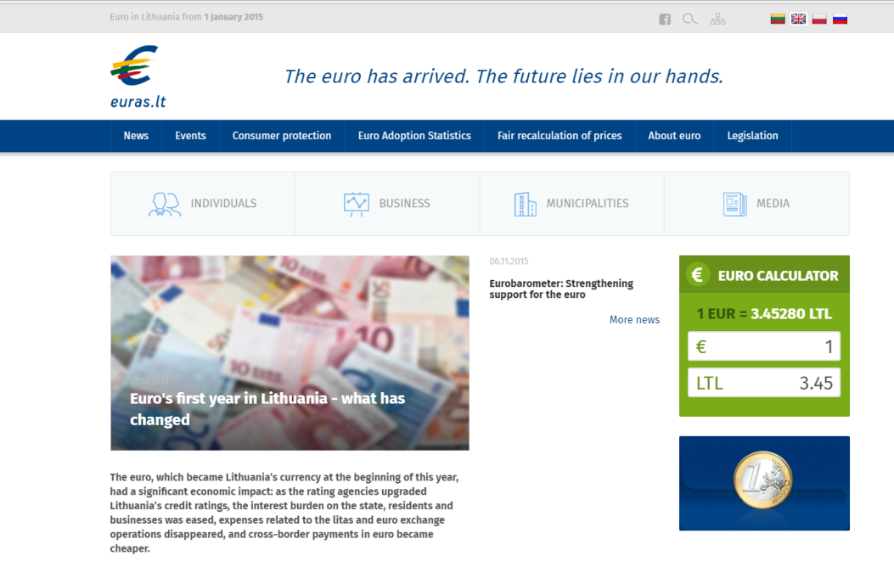
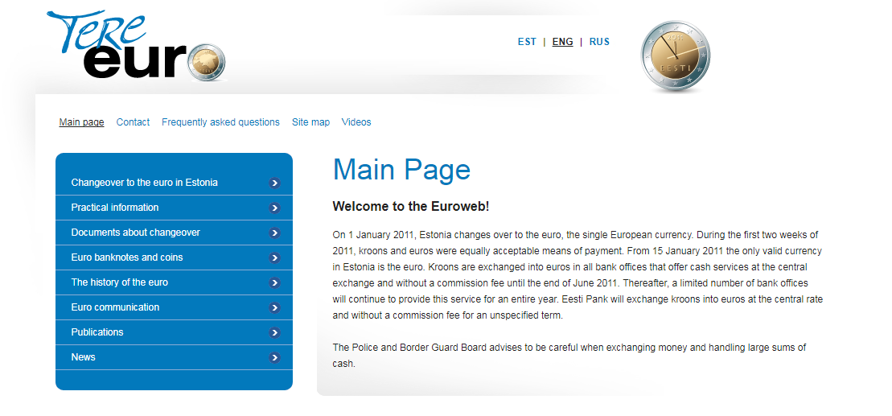
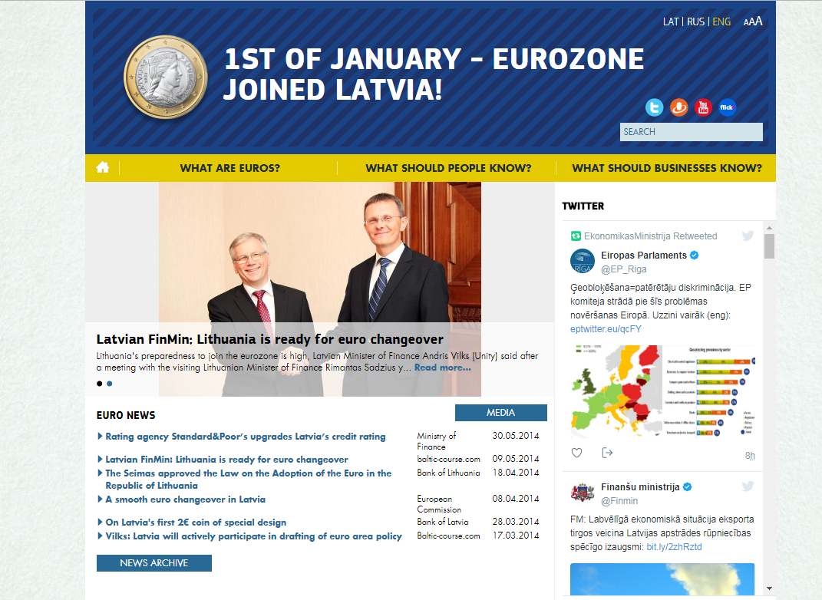
Baltic states united in euro: in 2011, 2014 and 2015
Notes:
http://www.euro.lt/pl/

Slide 4
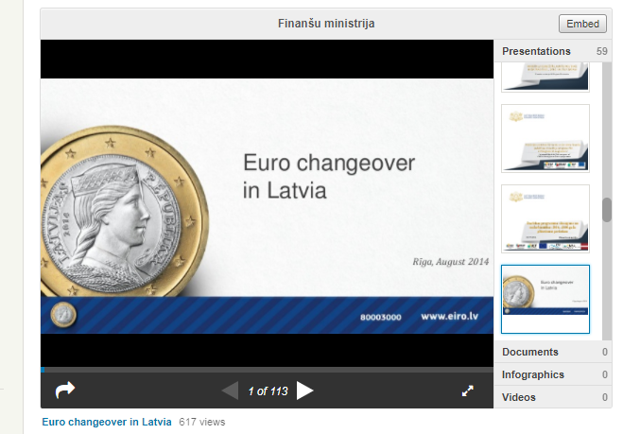
Euro introduction in Latvia
Comprehensive technical presentation on the status before and six months after the introduction of the euro in Latvia
Available at the Ministry of Finance of the Republic of Latvia website: https://www.slideshare.net/FinMin/euro-changeover-in-latvia-37950159

Slide 5
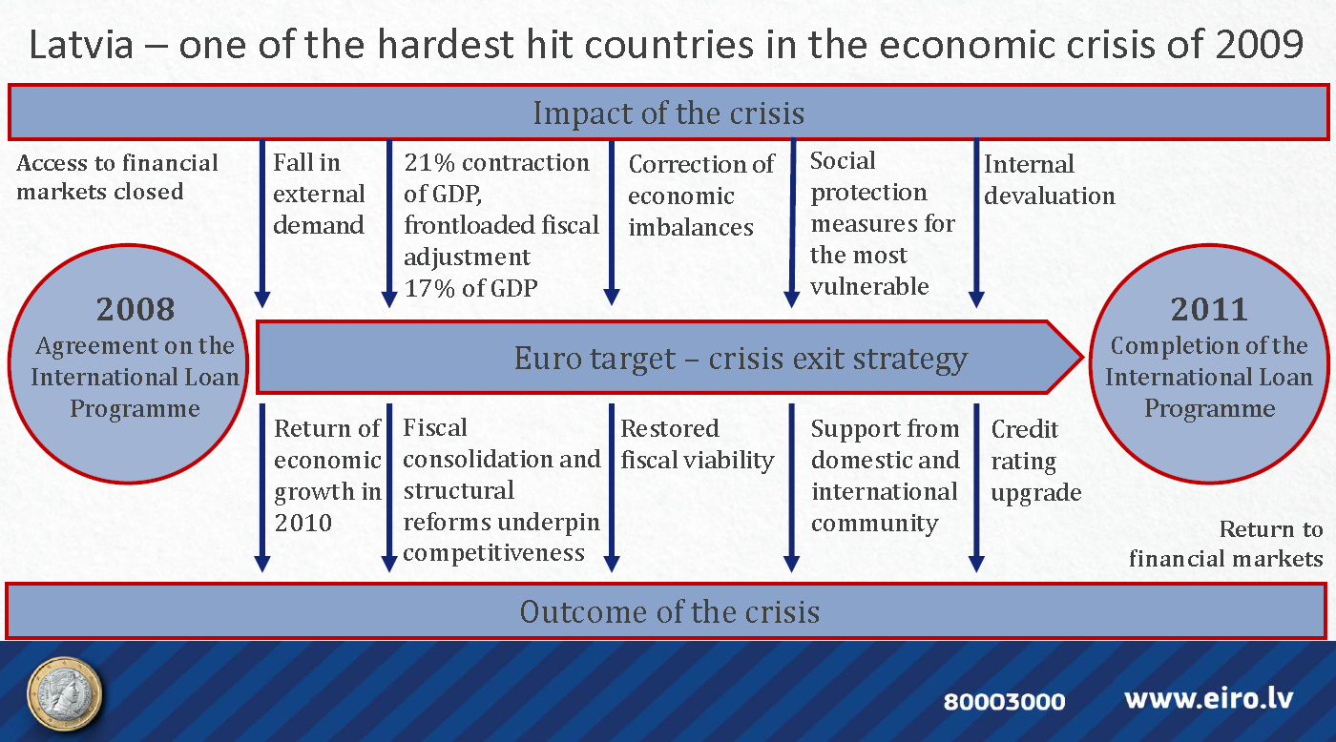

Slide 6
Inflation – 2% plus convergence 0.5% points
One of the implicit goals of the euro introduction is low inflation in the euro area, i.e. 2%
Another indirect impact was that the euro introduction helped to stabilise the price level before the introduction of the new currency
Source: Eurostat

Slide 7
GDP per capita in PPS
Lithuania has enjoyed stable growth and it is possbile that the introduction of the euro was an additional stimulus for structural reforms
Without regular and continuous policy measures, the currency cannot work miracles
Source: Eurostat

Slide 8
Unemployment
In a ten year perspective, the business cycles of the Baltics and Poland diverged
Recent trends suggest that the economy is warming up, but this is not related to the currency
Source: Eurostat

Slide 9
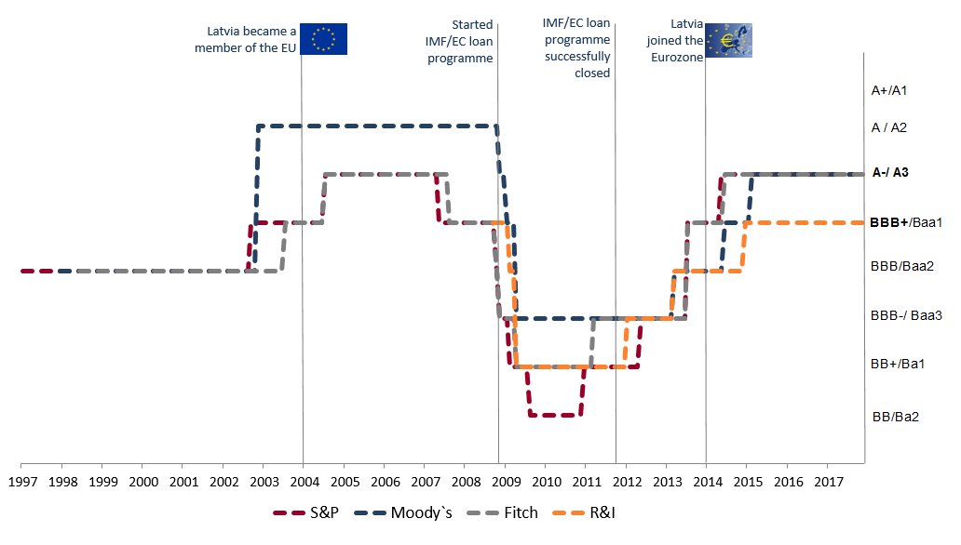
Credit ratings
Source: The Treasury

Slide 10
Baltic shadow economy index, % of GDP
Source: Shadow economy index in Baltic States 2009-2016, SSE Riga
Notes:
https://www.sseriga.edu/download.php?file=/files/news/arnissauka.pdf

Slide 11
Government revenue and expenditures
Source: Eurostat
Notes:
End of 2016

Slide 12
General government expenditure by functions in 2015, % of GDP
Source: Eurostat

Slide 13
Debt in 2016 and budget balance
Source: Eurostat
Notes:
End of 2016

Slide 14
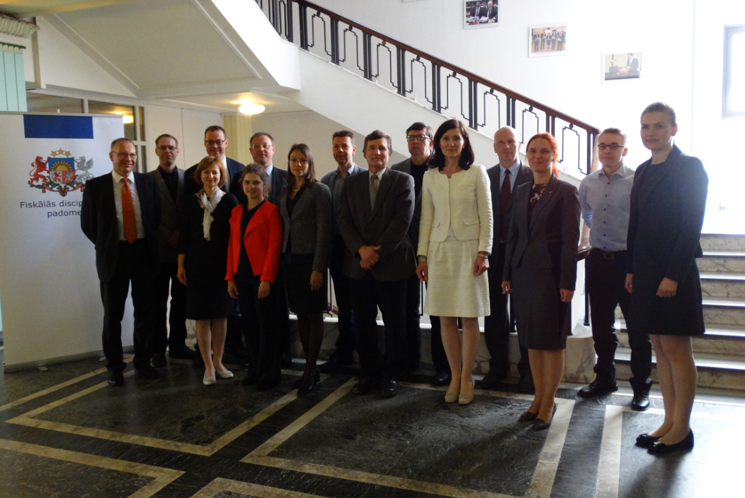
Independent fiscal councils
Our role is to assess fiscal policies and performance against macroeconomic objectives
Fiscal councils directly contribute to the public debate on fiscal policy by providing independent analysis and raising awareness about the consequences of certain policies

Slide 15
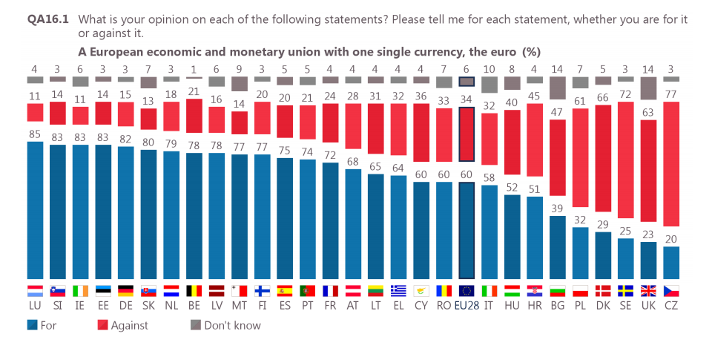
Are the citizens satisfied with the euro currency, what are the opinions?
Source: Eurobarometer, August 2017
Notes:
Support for the European economic and monetary union with one single currency, the euro: national results and evolutions A majority of respondents are in favour of “a European economic and monetary union with one single currency, the euro” in 22 Member States, with the highest scores in Luxembourg (85%), Slovenia (83%), Ireland (83%), Estonia (83%), Germany (82%) and Slovakia (80%). Conversely, majorities of respondents oppose the euro in six Member States, all located outside the euro area: the Czech Republic (77% “against”), Sweden (72%), Denmark (66%), the United Kingdom (63%), Poland (61%) and Bulgaria (47% vs. 39% “for”).
http://ec.europa.eu/commfrontoffice/publicopinion/index.cfm/Survey/getSurveyDetail/instruments/STANDARD/surveyKy/2142
We are more happy (2014-2016 against 2005-2007) ☺ http://worldhappiness.report/wp-content/uploads/sites/2/2017/03/HR17.pdf p.27 ☺

Slide 16
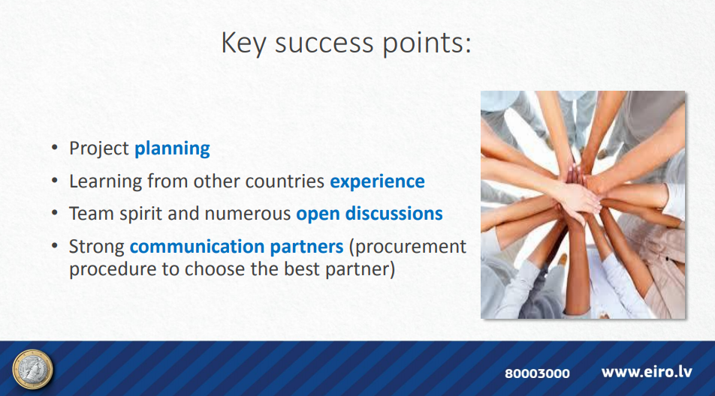
Notes:
Full presentation on euro changeover lessons at the Latvian MoF website
https://www.slideshare.net/FinMin/euro-changeover-in-latvia-37950159

Slide 17
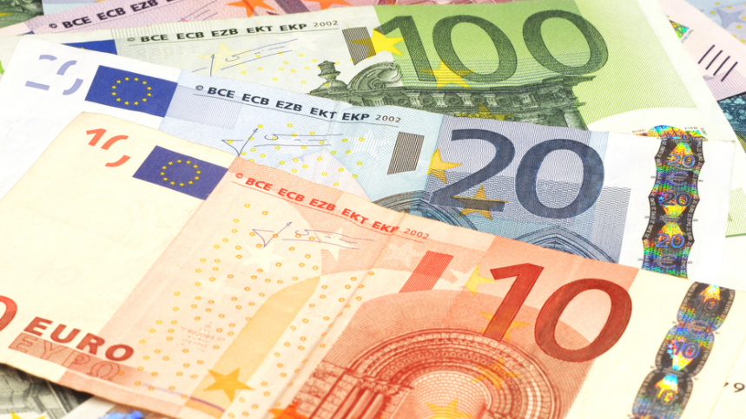

Challenges in technical changeover
Open communication and immediate problem solving
Take all advantages that are provided by innovations and tools
Very detailed and publicly available place ever since the project started in 2005

Slide 18
Thank You for your attention!
Your questions?
Fiskālās disciplīnas padome
Smilšu ielā 1-512 Rīgā LV-1919
Tālr.: +371 6708 3650
E-pasts: info@fdp.gov.lv
Mājaslapa: http://fdp.gov.lv
Twitter: @Fiskalapadome
Facebook: fiskalapadome

